Slide 1

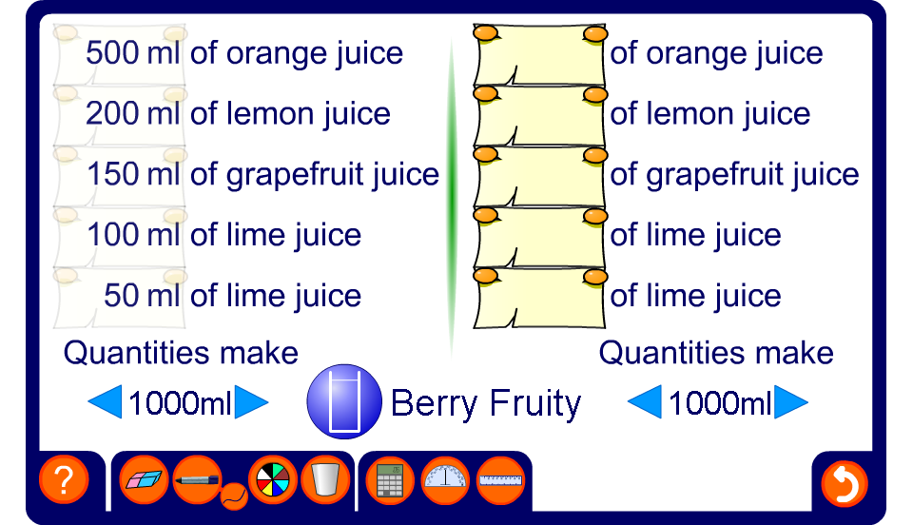


Fruit cocktail recipes
Notes:
Start by choosing a recipe.
The ingredients needed to make one litre are shown by default but this can be modified as required.

